Slide 1
DESIGN RULES

Slide 2
Golden rules and heuristics
“Broad Brush” design rules
Useful check list for good design
Different collections of design rules includes such as
  Shneiderman’s 8 Golden Rules
  Norman’s 7 Principles
  Nielsen’s 10 Heuristics

Slide 3
SHNEIDERMAN’S 8 GOLDEN RULES

Slide 4
Shneiderman’s 8 Golden Rules
1. Strive for consistency
2. Cater to Universal Usability (Enable frequent users to use shortcuts)
3. Offer informative feedback
4. Design dialogs to yield closure
5. Offer error prevention and simple error handling
6. Permit easy reversal of actions
7. Support internal locus of control
8. Reduce short-term memory load

Slide 5
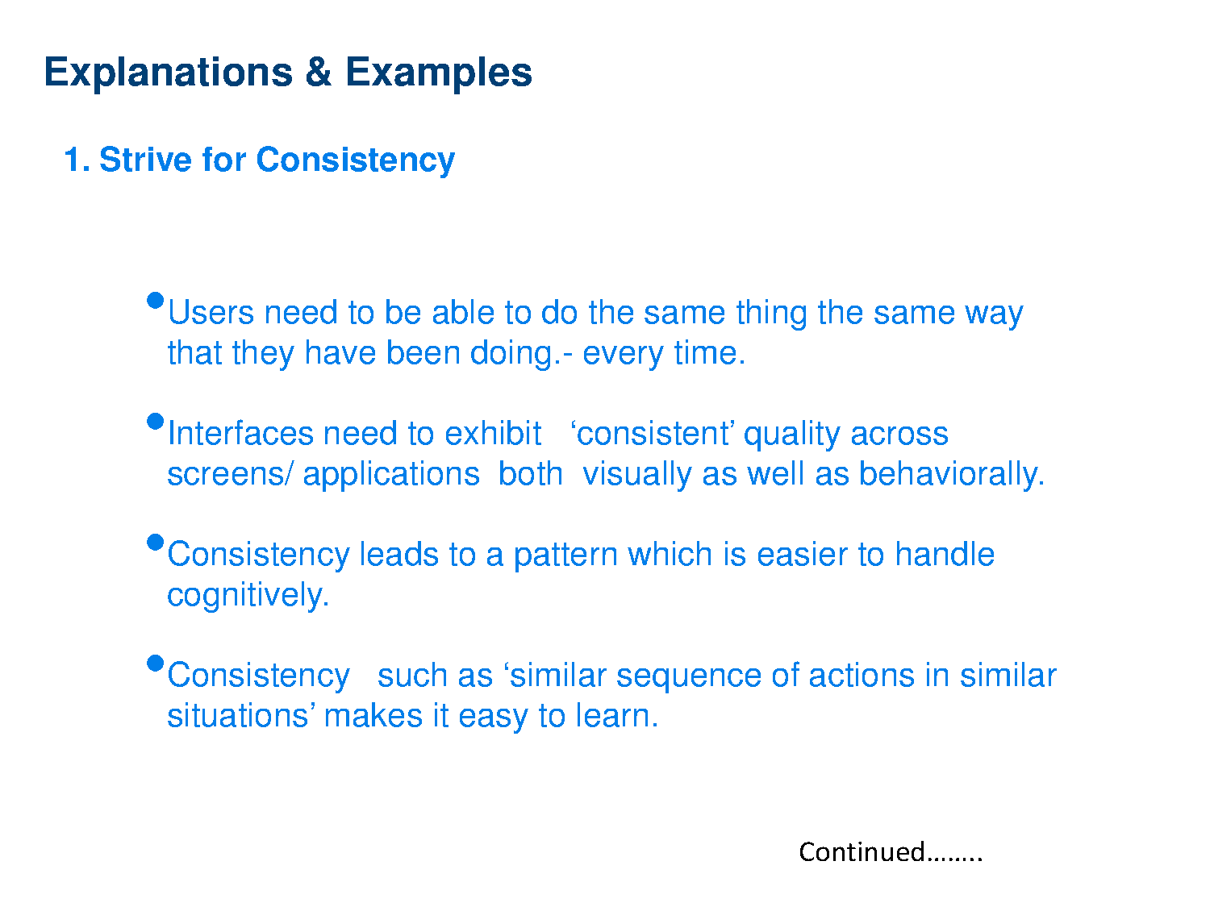

Slide 6
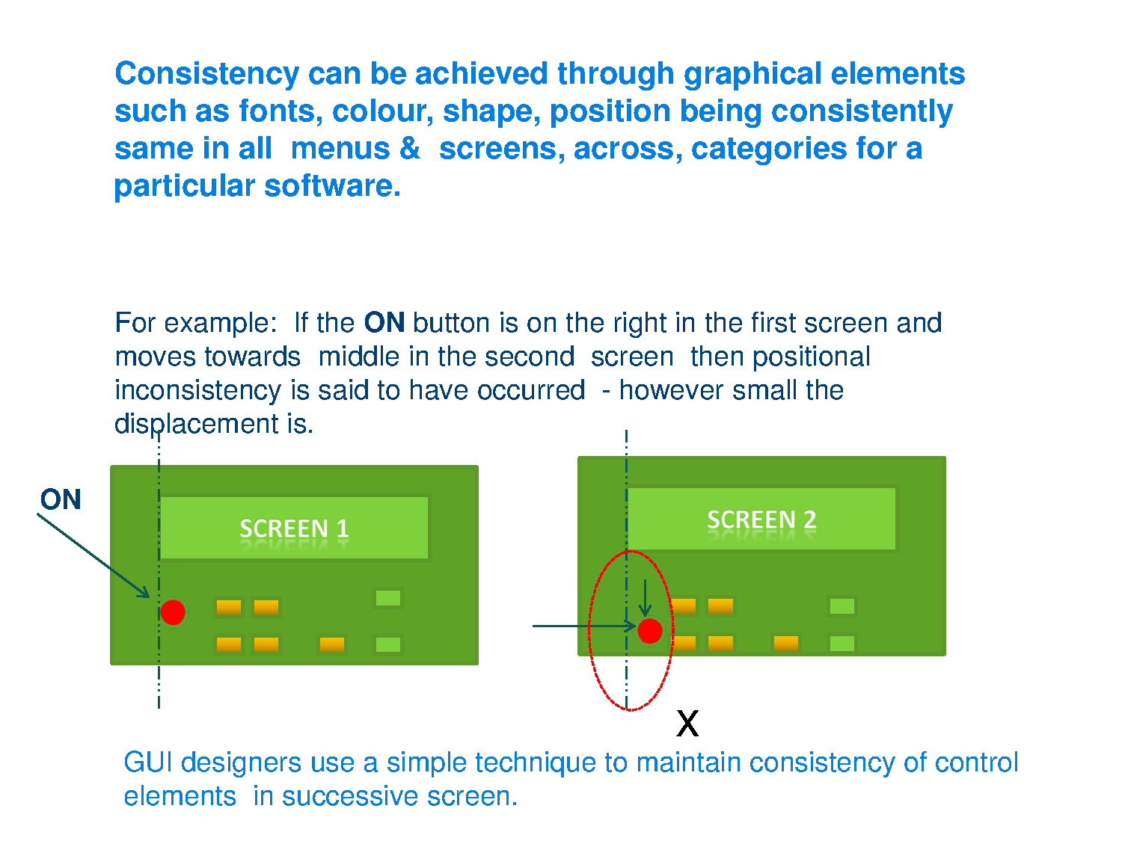

Slide 7
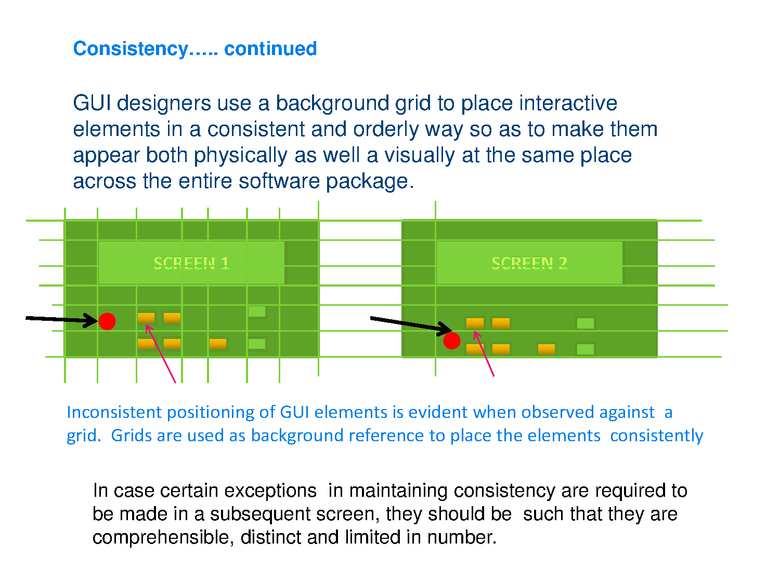

Slide 8
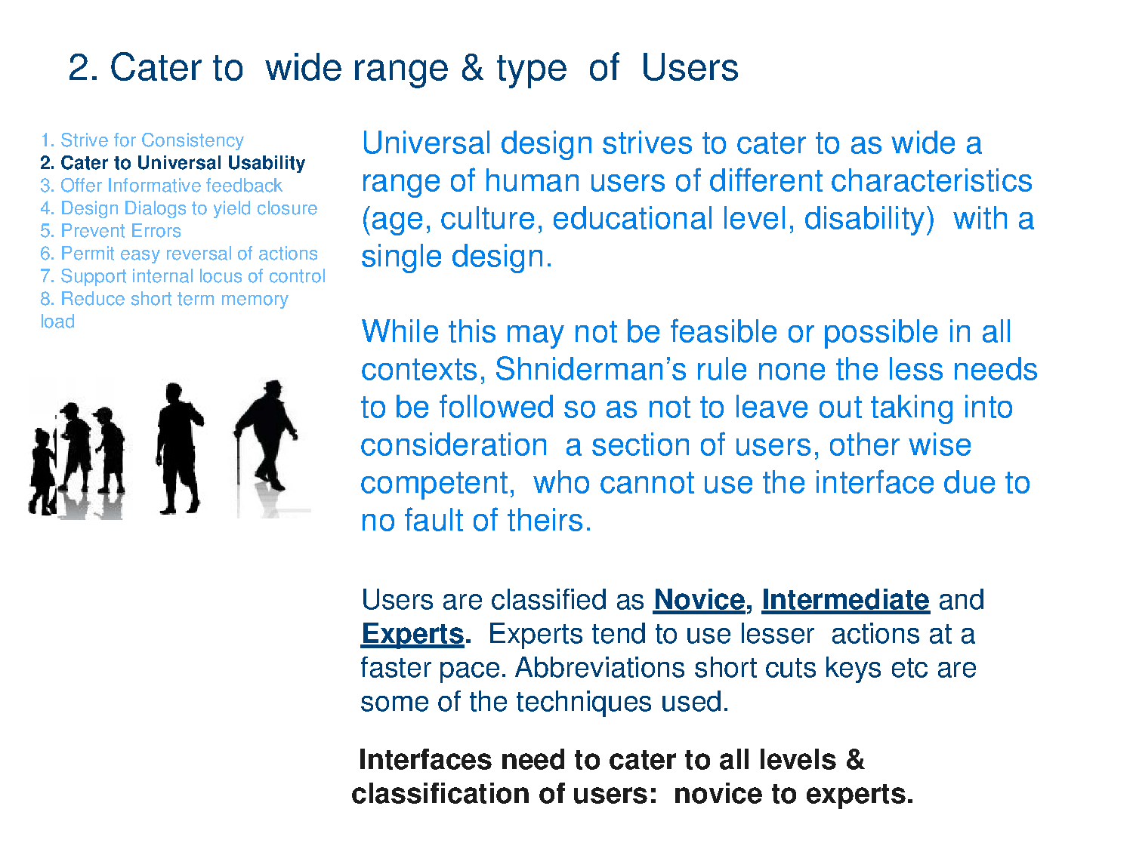
Notes:
Novice → Beginner, initiate, trio ( Some

Slide 9
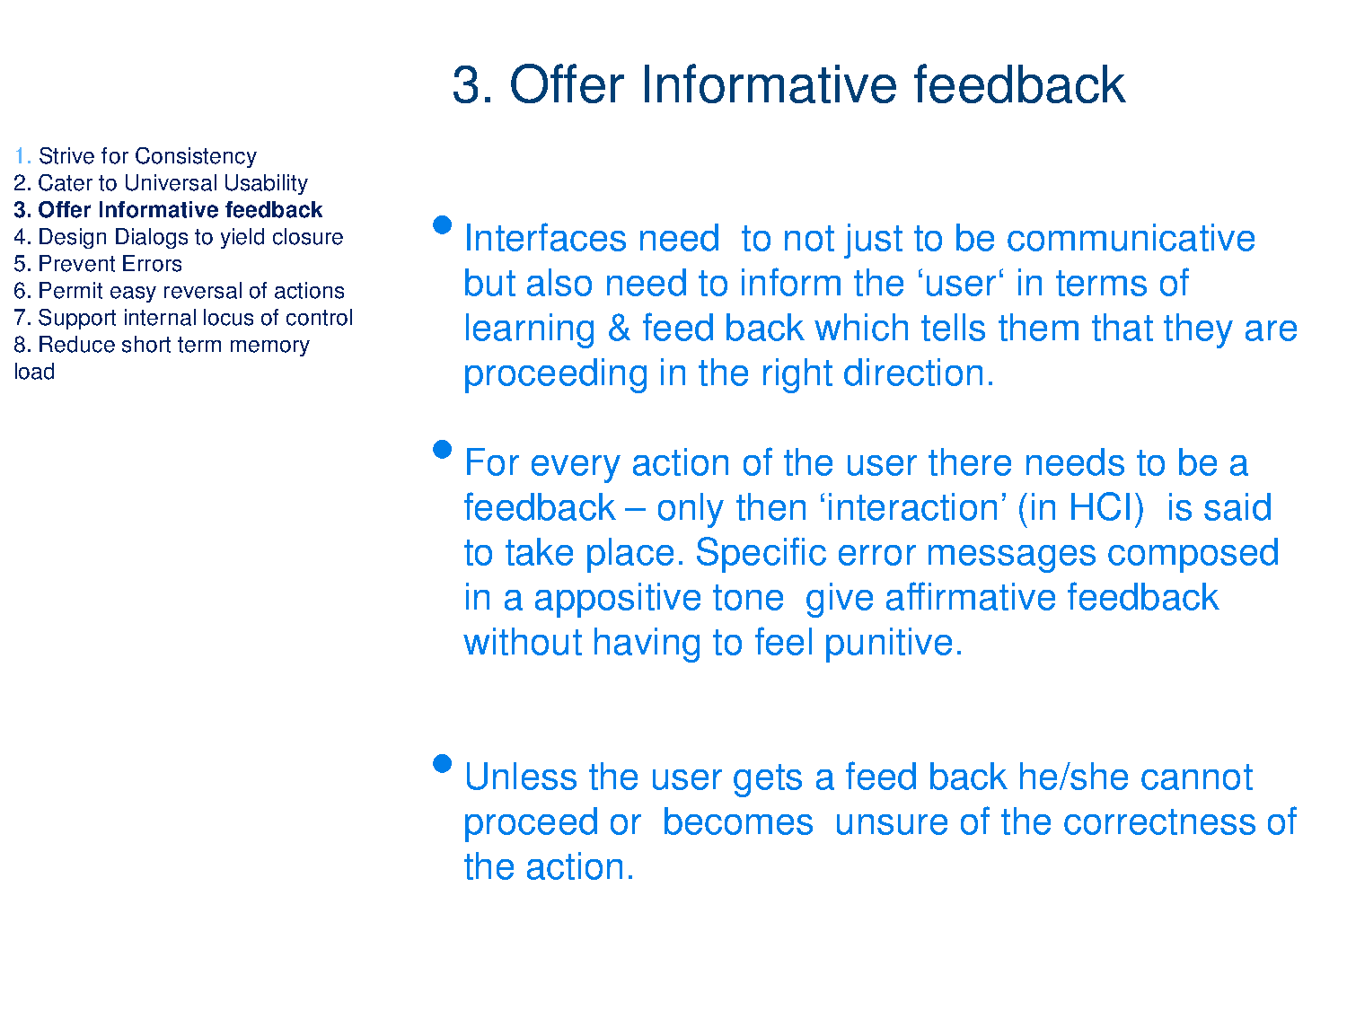

Slide 10
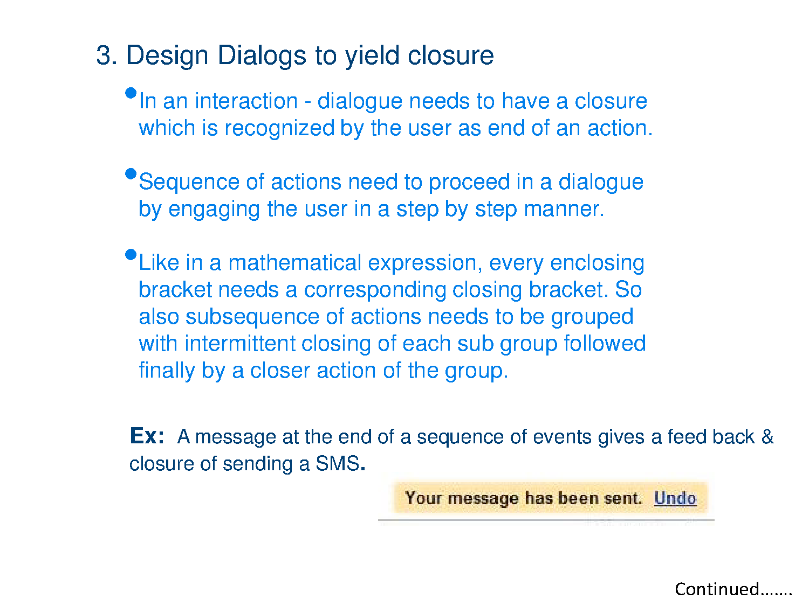
4.

Slide 11
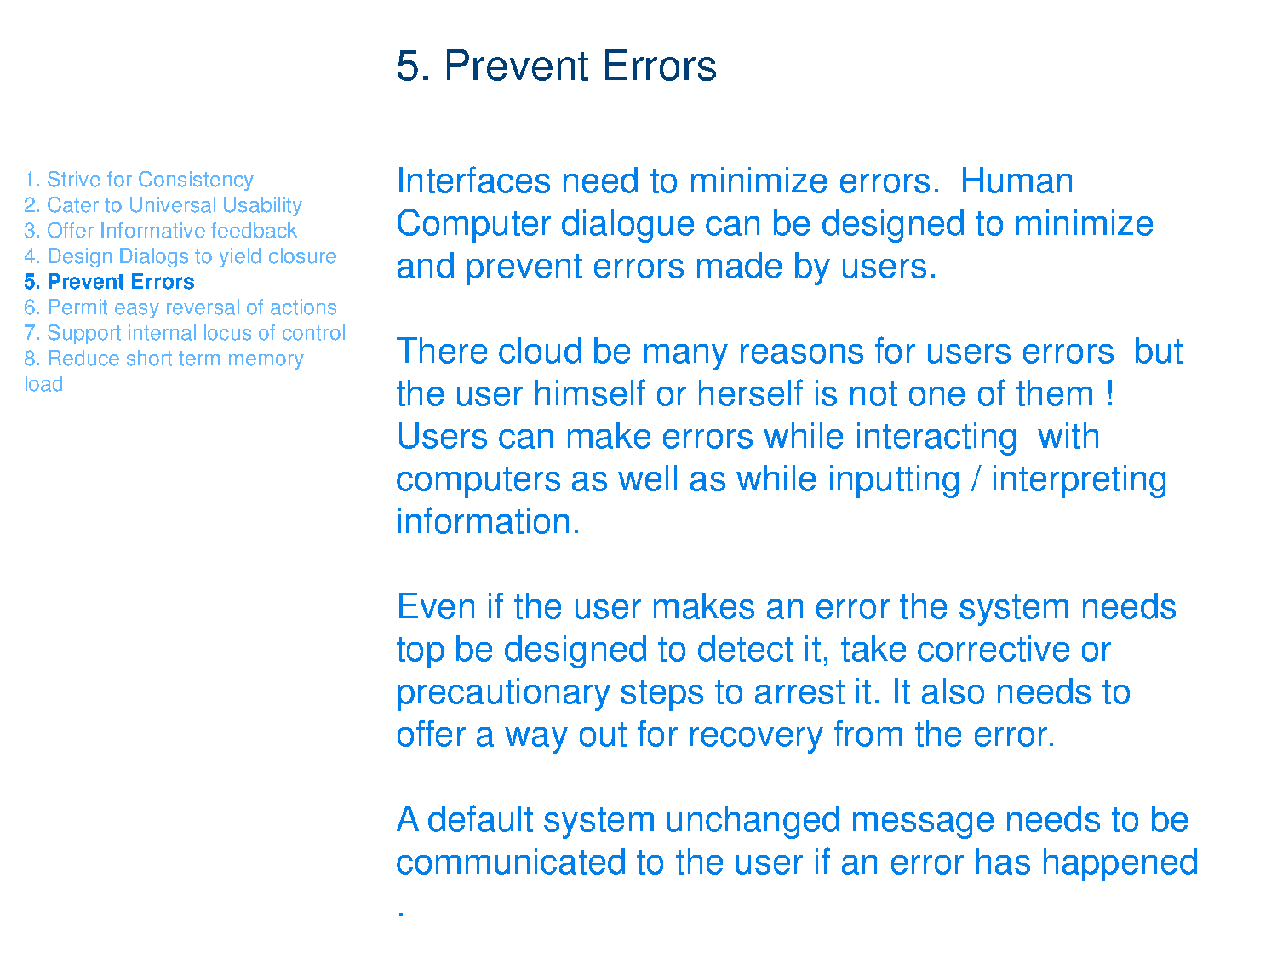

Slide 12
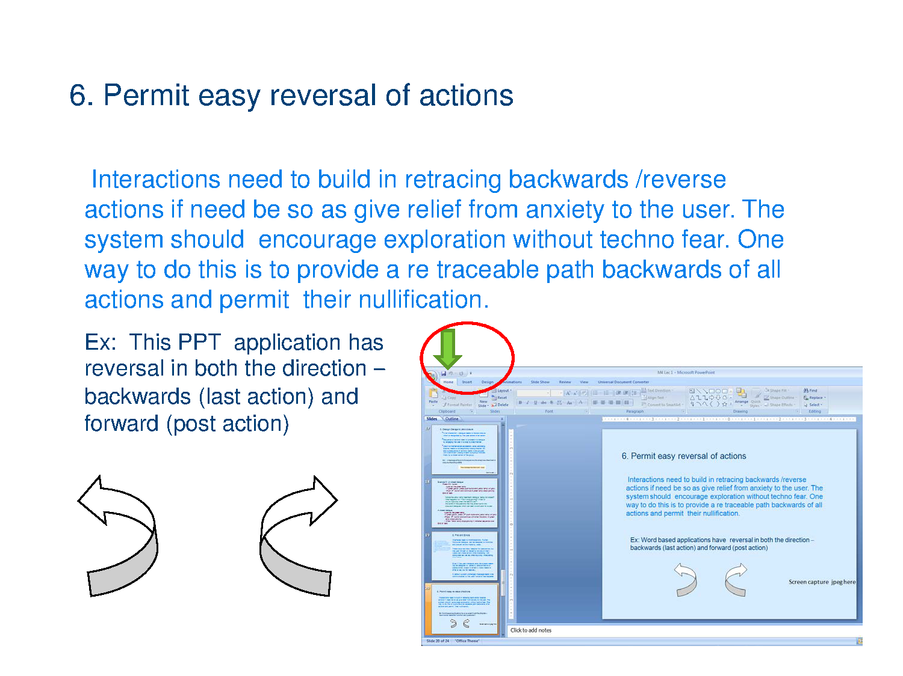

Slide 13
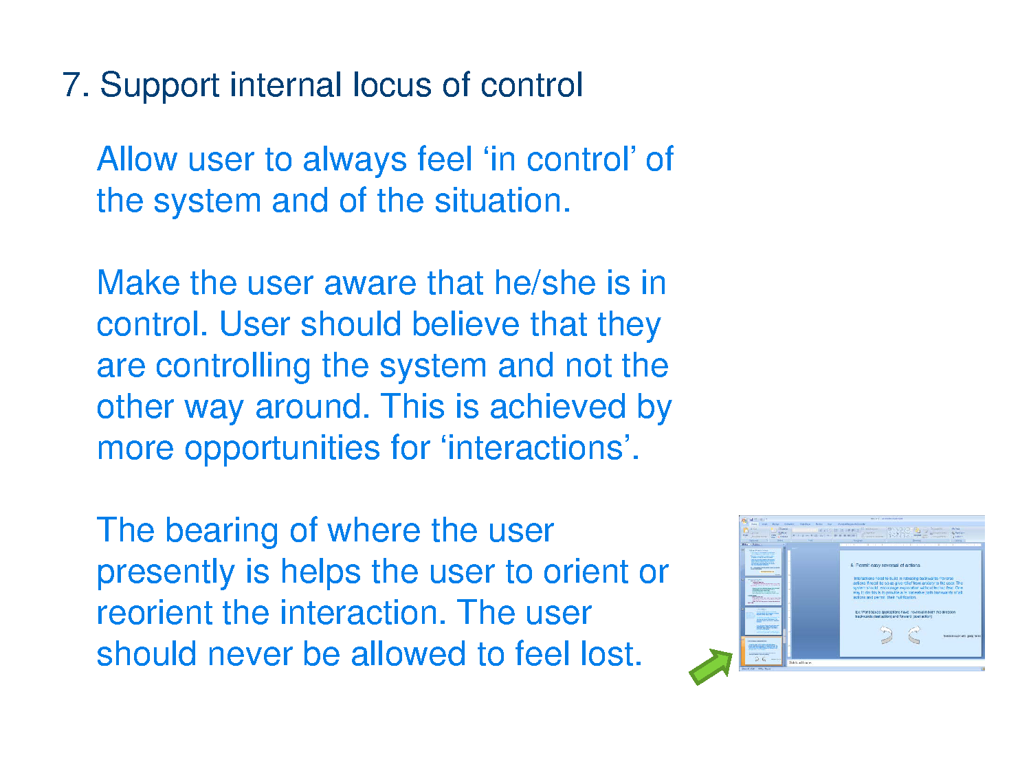

Slide 14
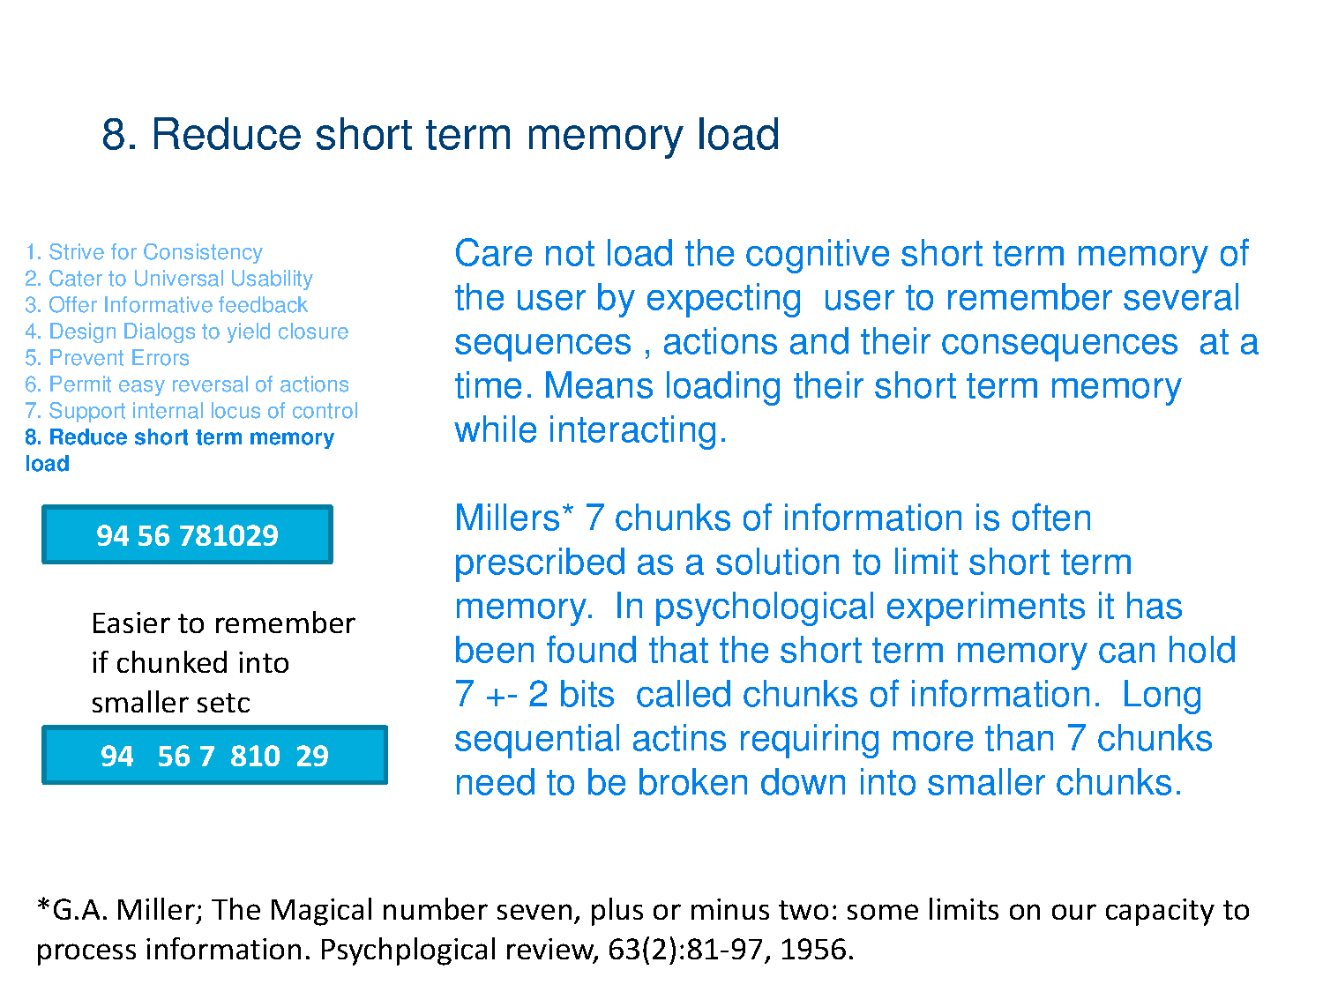

Slide 15
